Slide 1
Making scholarly communication great again.
Do institutional repositories still have a role?

Slide 2
We going to build a wall around your papers
Today’s situation
And make libraries pay for it

Slide 3
We going to build a wall around your papers
Some people’s view of Gold OA
Authors
And make libraries pay for it

Slide 5
UK situation
Ref – research excellence framework
http://www.hefce.ac.uk/rsrch/oa/FAQ/
The policy states that, to be eligible for submission to the next REF, authors’ final peer-reviewed manuscripts must have been deposited in an institutional or subject repository. Deposited material should be discoverable, and free to read and download, for anyone with an internet connection.
The policy now states that outputs accepted from 1 April 2016 onwards can be deposited in a repository at any point between acceptance and up to three months after the date of publication.¹

Slide 7
Mandates worldwide
http://roarmap.eprints.org/dataviz2.html
Notes:
Registry of open access repositories mandates and policies – mandates are worldwide

Slide 8
Notes:
Eric Van de Velde The Institutional Repository (IR) is obsolete. Its flawed foundation cannot be repaired. The IR must be phased out and replaced with viable alternatives. I believed in IRs. I advocated for IRs. The IR is not equivalent with Green Open Access. The IR is only one possible implementation of Green OA. With the IR at a dead end, Green OA must pivot towards alternatives that have viable paths forward: personal repositories, disciplinary repositories, social networks, and innovative combinations of all three.
Richard Poynder So while the OA movement may now appear unstoppable there is a growing sense that both the institutional repository and green OA have lost their way. It is not hard to see why. Not only are most researchers unwilling to self-archive their papers, but they remain sceptical about open access per se. Consequently, despite a flood of OA mandates being introduced by funders and institutions, most IRs remain half empty. What content they do contain often consists of no more than the bibliographic details of papers rather than the full text.

Slide 9
“The Institutional Repository (IR) is obsolete. Its flawed foundation cannot be repaired. The IR must be phased out and replaced with viable alternatives”
Eric Van de Velde
“So while the OA movement may now appear unstoppable there is a growing sense that both the institutional repository and green OA have lost their way. It is not hard to see why. Not only are most researchers unwilling to self-archive their papers ….. despite a flood of OA mandates being introduced by funders and institutions, most IRs remain half empty. “
Richard Poynder
Notes:
Eric Van de Velde The Institutional Repository (IR) is obsolete. Its flawed foundation cannot be repaired. The IR must be phased out and replaced with viable alternatives. I believed in IRs. I advocated for IRs. The IR is not equivalent with Green Open Access. The IR is only one possible implementation of Green OA. With the IR at a dead end, Green OA must pivot towards alternatives that have viable paths forward: personal repositories, disciplinary repositories, social networks, and innovative combinations of all three.
Richard Poynder So while the OA movement may now appear unstoppable there is a growing sense that both the institutional repository and green OA have lost their way. It is not hard to see why. Not only are most researchers unwilling to self-archive their papers, but they remain sceptical about open access per se. Consequently, despite a flood of OA mandates being introduced by funders and institutions, most IRs remain half empty. What content they do contain often consists of no more than the bibliographic details of papers rather than the full text.
What content they do contain often consists of no more than the bibliographic details of papers rather than the full text.

Slide 10
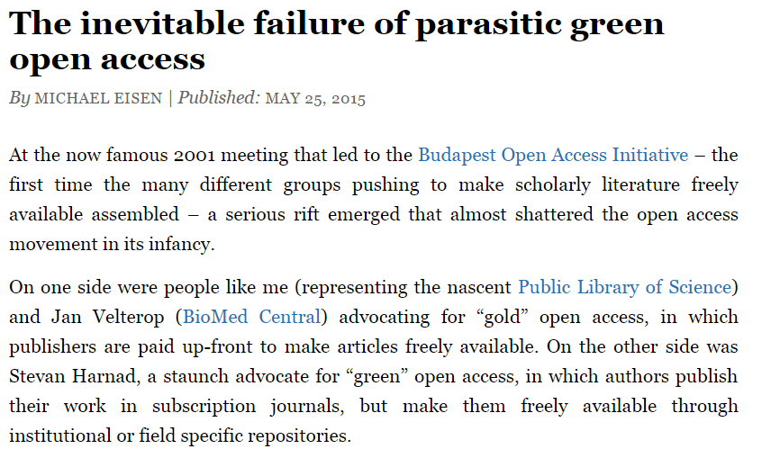
Rumors of IR’s death are not new
Dorothea Salo
Michael Essien

Slide 11
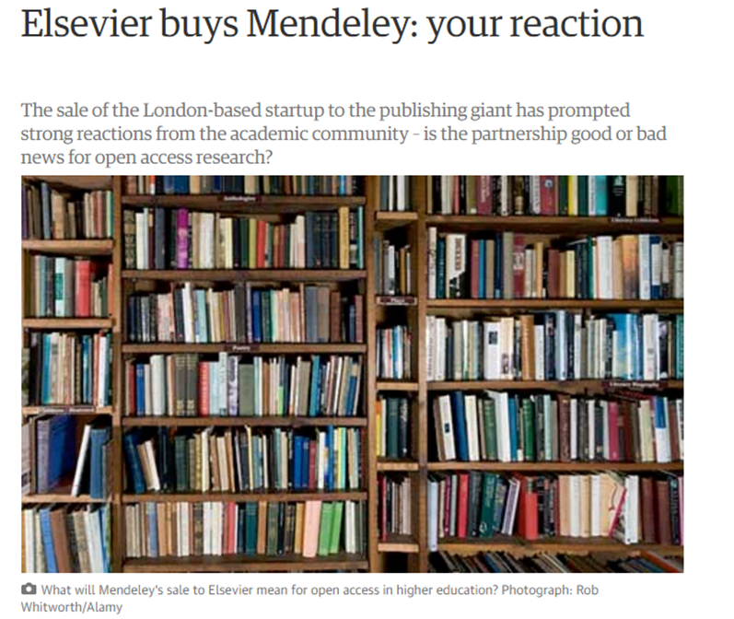
Elsevier snaps up SSRN!
http://savageminds.org/2016/05/18/its-the-data-stupid-what-elseviers-purchase-of-ssrn-also-means/
https://www.theguardian.com/higher-education-network/blog/2013/apr/10/elsevier-buys-mendeley-academic-reaction

Slide 12
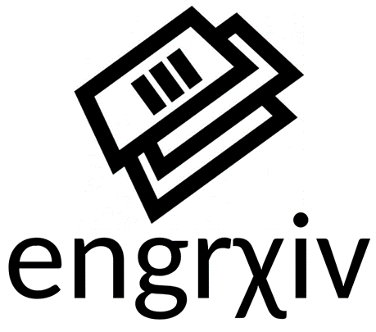
The rise of subject repositories?
ChemRxiv
Notes:
At Peter Suber on the state of Open Access a few days ago, someone asked Peter suber, given the difficulty/struggle of growing IRs and given the poping up of subject repositories what is the future of IR? https://www.youtube.com/watch?v=hnr7Wsyz3SA&feature=youtu.be

Slide 13
Competition from ResearchGate/Academia.edu
Bosman J, Kramer B: Global survey on research tool usage. Zenodo. 2016 https://dx.doi.org/10.5281/zenodo.49583

Slide 14
Uncertain future
Notes:
Many reasons – commercial, spammy, not exportable, but uncertain future
Will academia.edu, RG become too big to fail like Facebook ?

Slide 15
There is competition!
Institutional
Subject
Academic Social Networks
VS
VS

Slide 16
IRs do not contribute a big share?
Archambault, É., Amyot, D., Deschamps, P., Nicol, A., Provencher, F., Rebout, L., & Roberge, G. (2014). Proportion of open access papers published in peer-reviewed journals at the European and world levels—1996–2013.

Slide 17
IRs do not contribute a big share?
“Green OA papers, those deposited in institutional repositories, do not contribute a large share of the overall OA stock of papers…. Other forms of OA—Gold OA Papers (that is, those with article processing charges published in subscription journal or so-called hybrid journals), Green DOA and Gold DOA (embargoed self-archiving and embargoed journals), ROA (Robin Hood or Rogue OA) and papers archived
in non-institutional repositories such as ResearchGate—account for a large part of the pie. “
Archambault, É., Amyot, D., Deschamps, P., Nicol, A., Provencher, F., Rebout, L., & Roberge, G. (2014). Proportion of open access papers published in peer-reviewed journals at the European and world levels—1996–2013.

Slide 18
Why not IRs?
Researchers are
Unaware of IRs due to lack of publicity
find IR software too hard to use
too busy and/or do not see any motivation for depositing
Worried about copyright – require the right copy
Prefer to deposit to subject repositories (SSRN), social research networks/profiles (ResearchGate)

Slide 19
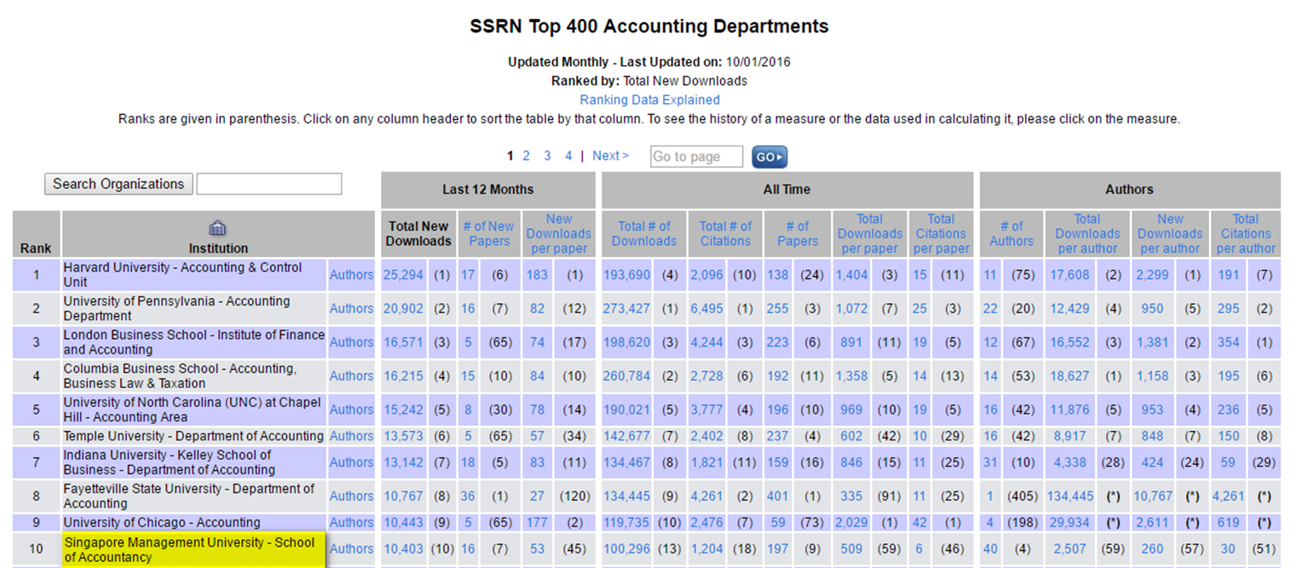
Strengths of subject repositories
Researchers think along disciplinary lines not institutional lines
More visibility to specific discipline
Statistics/features can be discipline specific + comparisons across institution

Slide 20
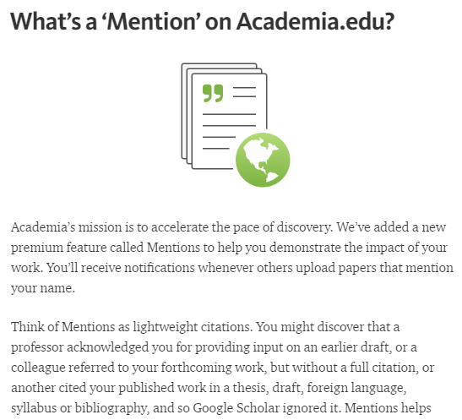
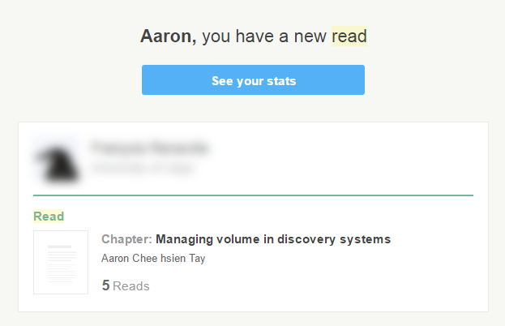
Strengths of academic social networking sites like researchgate
Networking - follow researchers, ask questions
Statistics/features can compare across institution
More innovative features
Notes:
Some

Slide 21
Distributed vs Centralized
Notes:
Centralized vulnerable to be purchased/taken down.

Slide 22
Interoperability = Size matters not
Centralised service
Central Repository eg SSRN/ResearchGate
VS
IR
IR
IR
IR
Standardize
Full text availability
Publication type
Subject headings
Unique identifiers & usage stats
Way to push metadata and full text
Notes:
Irs alone, siloed are almost useless, you can’t aggregate to compare across institutions. No mass.
BASE, CORE, Share
Only digital commons network…

Slide 23
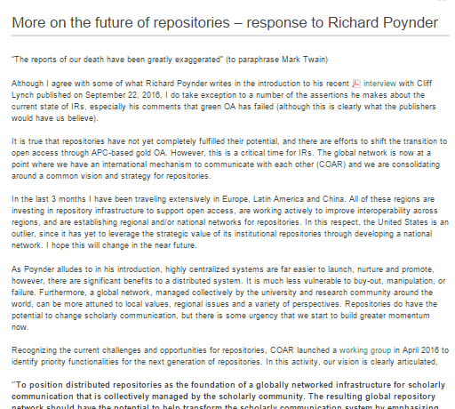
https://www.coar-repositories.org/news-media/more-on-the-future-of-repositories-response-to-richard-poynder/

Slide 24
Possible futures
(not mutually exclusive)

Slide 25
Scenario I
Institutional repositories will focus on other goals besides collecting deposits of published articles

Slide 26
Other futures for IRS
“to serve as tangible indicators of a university's quality and to demonstrate the scientific, societal, and economic relevance of its research activities, thus Increasing the institution's visibility, status, and public value” (Crow 2002)
Nurture new forms of scholar communication beyond traditional publishing (e.g ETD, grey literature, data archiving) – (Clifford 2003)
Challenge traditional publishing as overlay journals
Notes:
Crow, Raym. “The Case for Institutional Repositories: A SPARC Position Paper,” SPARC, 2002. Accessed August 5, 2016, https://ils.unc.edu/courses/2015_fall/inls700_001/Readings/Crow2002- CaseforInstitutionalRepositoriesSPARCPaper.pdf.
Lynch, Clifford. “Institutional Repositories: Essential Infrastructure for Scholarship in the Digital Age,” ARL Bimonthly Report 226 (February 2003), 1-7. Accessed August 5, 2016. http://www.arl.org/component/content/article/6/1229.
Discrete analysis

Slide 27
Scenario II
Interoperability between repositories prevails! Institutional repositories will be equal valued partners along-side Subject repositories
Notes:
COAR gets their way. Interopertability. Until Green OA reaches a high enough %, and publishers start to lengthen embargos… request-a-copy Button

Slide 28
Scenario III
Institutional repositories integrates with other systems and into author’s workflow

Slide 29
Integration with University publication management system
Auto-harvest metadata
Enter record metadata
Increased visibility downloads
Attach appropriate copy
Grant management
Faculty profile/CV
Performance appraisal
Other systems
Notes:
Even with mandates we are struggling… MIT boasts 44% of output captured. Unviersity of Nebraska has 40% faculty participant rate

Slide 30
Competition or complement?

Slide 31
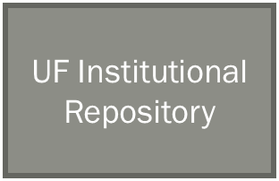
Integration with publishers (I)
Metadata of articles by UF authors
(from Elsevier)
ScienceDirect API
ScienceDirect API
Published version (Sciencedirect)
Russell, Judith C.; Wise, Alicia; Dinsmore, Chelsea S.; Spears, Laura I.; Phillips, Robert V.; and Taylor, Laurie (2016) "Academic Library and Publisher Collaboration: Utilizing an Institutional Repository to Maximize the Visibility and Impact of Articles by University Authors," Collaborative Librarianship: Vol. 8: Iss. 2, Article 4.
https://www.elsevier.com/solutions/sciencedirect/support/institutional-repository

Slide 32
How is this supporting open access?
Metadata of articles by UF authors
(from Elsevier)
ScienceDirect API
ScienceDirect API
Published version (Sciencedirect)
OR
author accepted manuscripts (phase 2)
Russell, Judith C.; Wise, Alicia; Dinsmore, Chelsea S.; Spears, Laura I.; Phillips, Robert V.; and Taylor, Laurie (2016) "Academic Library and Publisher Collaboration: Utilizing an Institutional Repository to Maximize the Visibility and Impact of Articles by University Authors," Collaborative Librarianship: Vol. 8: Iss. 2, Article 4.

Slide 33
Integration with publisher (II)
Authors submit preprint to subject repository
Publisher submission systems
Metadata/Full Text

Slide 34
Perfectly interoperable world

Slide 35
Scenario IV
Gold OA wins out – making the whole repositories debate moot.

Slide 36
aarontay
Aaron Tay
Library analytics manager, Singapore Management University
aarontay@gmail.com
musingsaboutlibrarianship.blogspot.sg

Slide 37
References
http://poynder.blogspot.sg/2016/09/q-with-cnis-clifford-lynch-time-to-re_22.html
https://poynder.blogspot.sg/2016/10/institutional-repositories-response-to.html?m=0
http://blog.dshr.org/2016/10/why-did-institutional-repositories-fail.html
http://ukcorr.org/2015/11/27/cris-and-retirement-of-repositories/
http://scitechsociety.blogspot.sg/2016/07/let-ir-rip.html

Slide 38
Self archiving of papers but of what and why?
Of what | When | Purpose | Example
Preprints (either working papers or submitted manscripts) | Before submission to journal | Speed up scientific communication | Typical subject repositories eg. Arxiv
Usually postprint(Accepted Manuscript) or final published version if allowed | Typically after publication | Access for “Scholarly poor”/ Citation advantage | Typical IRs
Usually Postprint(Accepted Manuscript) or final published version if allowed | On paper acceptance | Weaken traditional publishing models to universal Green OA leverage a favourable transition to “Fair Gold” (Hanard) | immediate-deposit/optional-access, ID/OA mandates – eg Liège Mandate
Preprints/working papers | Before submission to journal | Disrupt traditional publishing models recapture & compete scholarly comm infrastructure | Overlay journals and repositories eg Discrete Analysis

